Slide 1
欢迎大家选修
《专业研究英语》课程

Slide 2
参考书目：
计算机专业英语：科技交流与科技论文写作
候进 编著
电子工业出版社
主讲：刘凌

Slide 3
自我介绍：
刘凌
liulingcs@szu.edu.cn
计算机与软件学院
B.Sc: Nanjing University
M.Sc: Peking University
Ph.D: Imperial College London
Research：Information theory、Coding Theory、Network Security、AI+5G
主讲：刘凌

Slide 4
Marking Criteria：
elements | project | ratio | 说明
Class performance | Class quiz Homework Presentation | 20% 20% 20% | Some questions from materials. Write some essays after class. Oral presentation in class: to show some technical work in CS, e.g. introducing an algorithm, a device, a new skill…
Final exam | Technical report | 40% | Submit a report about the research area you are interested in. It may be like a review paper, e.g. Introducing deep learning or a new language like Python……

Slide 5
Expectation after this course:
How to read a research paper.
  Identify the body of it. (introduction、literature review、method、conclusion…..)
  Understand the idea of it. (give an oral speech to present the main story of it.)
How to write a research paper.
  Use the right tools (latex、ctex、ppt、word…)
  Present your idea formally（a further step based on your current writing skills）

Slide 6
Syllabus:
序 号 | 教学内容 | 学时 | 授课方式 | 课程目标 （指标点）
1 | 专业领域介绍，包括主流会议和期刊、资源访问等 | 2 | 讲授 | 6（6.3），10（10.3）
2 | 分组专题介绍 | 4 | 讲授+综合练习 | 6（6.3），7（7.2），10（10.1）
3 | 文献收集和参考文献整理 | 4 | 讲授+综合练习 | 6（6.3），7（7.2），10（10.3）
4 | 综述论文结构和撰写思路 | 2 | 讲授 | 6（6.3），7（7.2），10（10.3）
5 | 范文学习 | 4 | 讲授+综合练习 | 6（6.3），7（7.2），10（10.1、10.3）
6 | 口头报告技巧 | 2 | 讲授 | 6（6.3），7（7.2），10（10.1、10.3）
7 | 口头报告范例学习 | 4 | 讲授+综合练习 | 6（6.3），7（7.2），10（10.1、10.3）
8 | 海报展示模板和实例分析 | 4 | 讲授+综合练习 | 10（10.1、10.3）
9 | 论文互评 | 4 | 讲授+综合练习 | 6（6.3），7（7.2），10（10.1、10.3）
10 | 学生口头报告 | 6 | 综合练习 | 10（10.1、10.3）
合计 |  | 36

Slide 7


1.1 my topic: information theory
主讲：易建勋
第<number>页 共102页
Notes:
教学讨论：
（1）
（2）
（3）

Slide 8
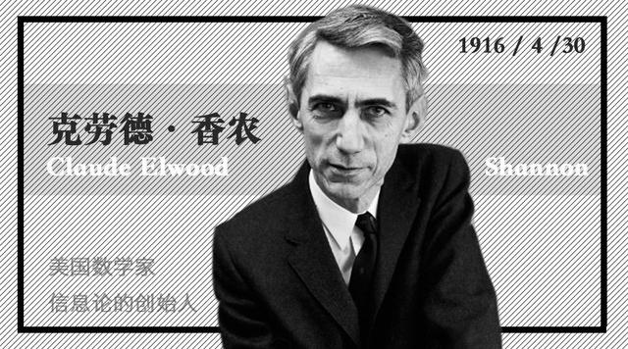


My topic: information theory
How to regenerate a message at another point almost correctly?

Slide 9
My topic: information theory
  Entropy: How to be an interesting (informative) person?
  Compression: How to be brief? (.rar, .jpg, .avi,….)
  Capacity: How to control your volume in a party?
  It is a topic about math, probability, inequalities…
Still sounds boring?

Slide 10
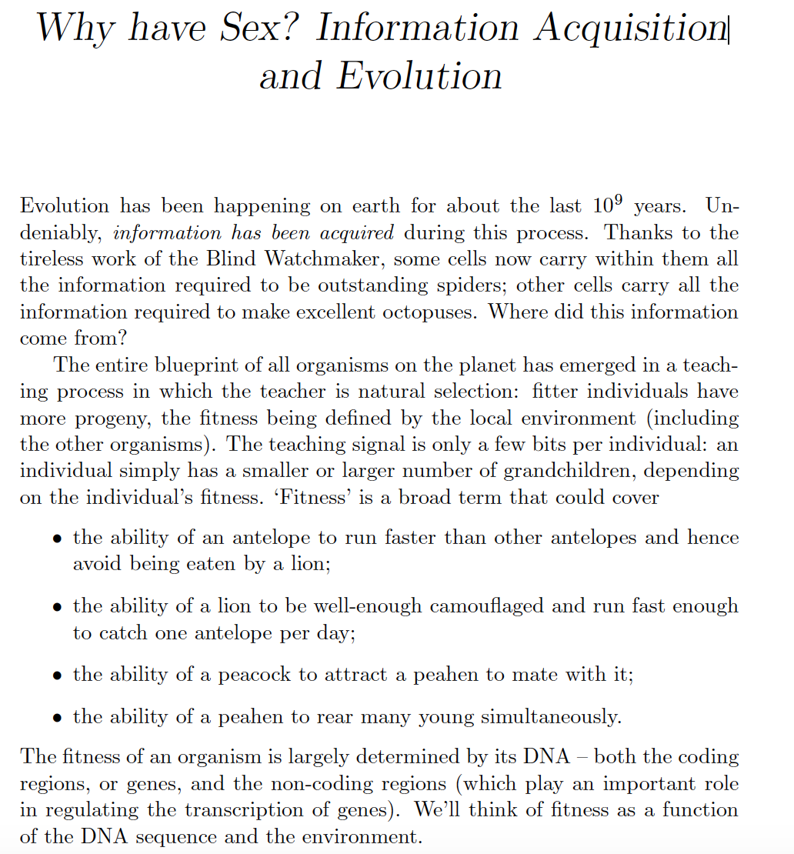
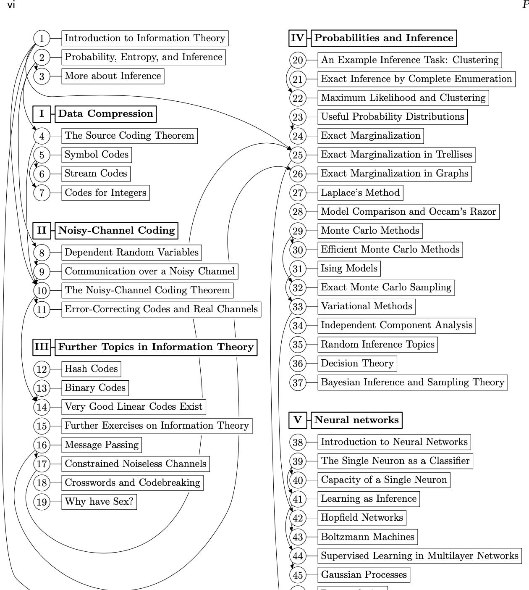
My topic: information theory
If you think about your DNA as a message and you want to
regenerate it somewhere. You might be interested.😃

Slide 11
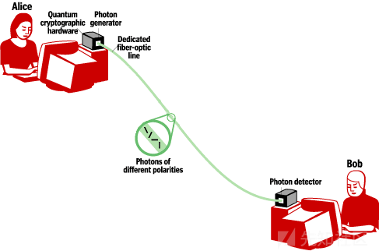
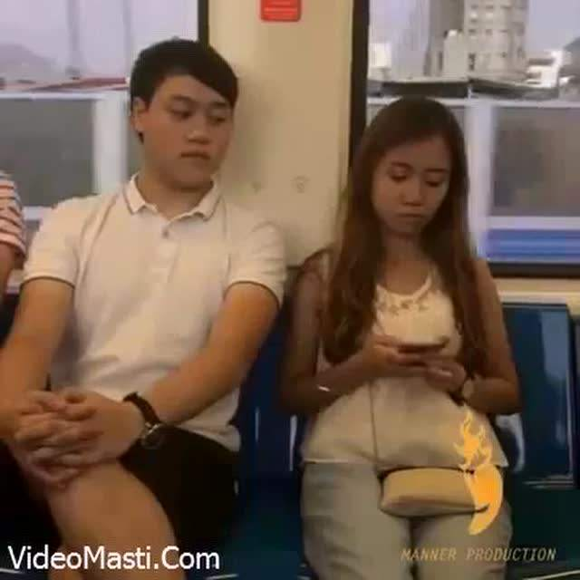
My topic: information theory
Network security: some bad guy wants to see your message!
  Security: How to be a hacker? (or how to prevent?)
  Key: Is key always necessary?
  Quantum Computer: Why are we afraid of it?
  Quantum key distribution: Why is Schrodinger’s cat better than
  a bit?

Slide 12
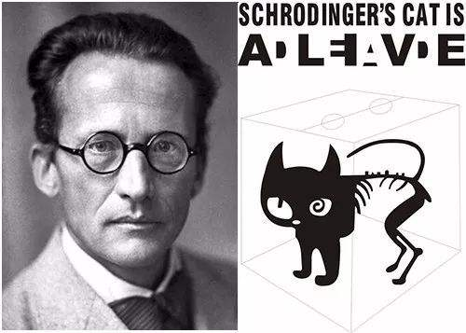
My topic: information theory
On making a cat suffer, no one knows better than this guy.
The cat can be both alive and dead, and both white and black,
like a suffering panda…

Slide 13
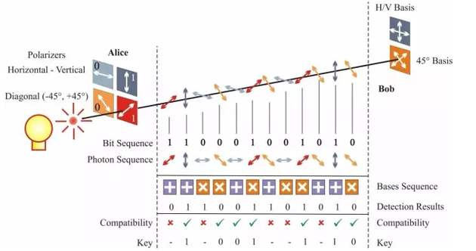
My topic: information theory
Why using this suffering panda can achieve a secure link?

Slide 14
My publications:
L. Liu, Y. Yan , C. Ling, and X. Wu, “Construction of Capacity-Achieving Lattice Codes: Polar lattices,” IEEE Trans. Commun.,2018.
Y. Yan, L. Liu, and C. Ling, “Polar Lattices for Strong Secrecy over the Gaussian Wiretap Channel,” Proc. IEEE Int. Symp. Inform. Theory, 2014.
L. Liu, Y. Yan, and C. Ling,“Secrecy-Good Polar Lattices with Optimal Shaping for the Gaussian Wiretap Channels,” IEEE Inform. Theory Workshop, 2015.
L. Liu, Y. Yan, and C. Ling, “Achieving Secrecy Capacity of the Gaussian Wiretap Channel with Polar Lattices,” IEEE Trans. Inform. Theory, 2018.
L. Liu, and C. Ling, “Polar Lattices are Good for Lossy Compression,” Proc. IEEE Inform. Theory Workshop, 2015.
L. Liu, and C. Ling, “Polar Lattices for Lossy Compression,” IEEE Trans. Inform. Theory, submitted.
L. Liu, J. Shi, and C. Ling, “Extracting Wyner’s Common Randomness Using Polar Codes," Proc. IEEE Wireless Commun. Signal Process., 2016.
J. Shi, L. Liu, Deniz Gündüz and C. Ling, “Polar Codes and Polar Lattices for the Heegard-Berger Problem," IEEE Trans. Commun., 2018.
L. Liu, and C. Ling, “Algebraic Polar Lattices for Independent Fading Channels,” Proc. IEEE Int. Symp. Turbo Code Iterative Inform., invited paper, 2018。
D. Tse, B. Li, K. Chen, L. Liu, and J. Gu, “Universal Polar Coding for Parallel Gaussian Channels," Proc. IEEE Int. Symp. Inform. Theory, 2019.
M. Zheng, , L. Liu, and C. Ling, “On the Polarization of Rényi Entropy,” Proc. IEEE Int. Symp. Inform. Theory, 2019.
…
第<number>页 共102页

Slide 15
Homework:
讨论：
  （1）Finish the given material: an introduction of information theory, and write a short summary of it.
  【本章结束】

